Slide 1
NLP - Text Classification

Slide 2

Contents
Import Libraries and the dataset
Text Preprocessing
Feature extraction
Train Test Split
Training Text Classification Model (Naïve Bayes)
Analyze the results on test set
Evaluate the Model
Saving and loading the Model

Slide 3
NLP Workflow
Textual Data Collection
Text Preprocessing
Exploratory Data Analysis
Evaluation and Deployment
Modelling or Pattern Mining
Vectorization and Feature Engineering
Text Normalization

Slide 4
Import Libraries and the dataset
The libraries which must be imported are
NumPy for mathematical computations
Pandas for operating on data frames
Nltk for natural language processing kit
PyCaret for modeling and evaluation

Slide 5
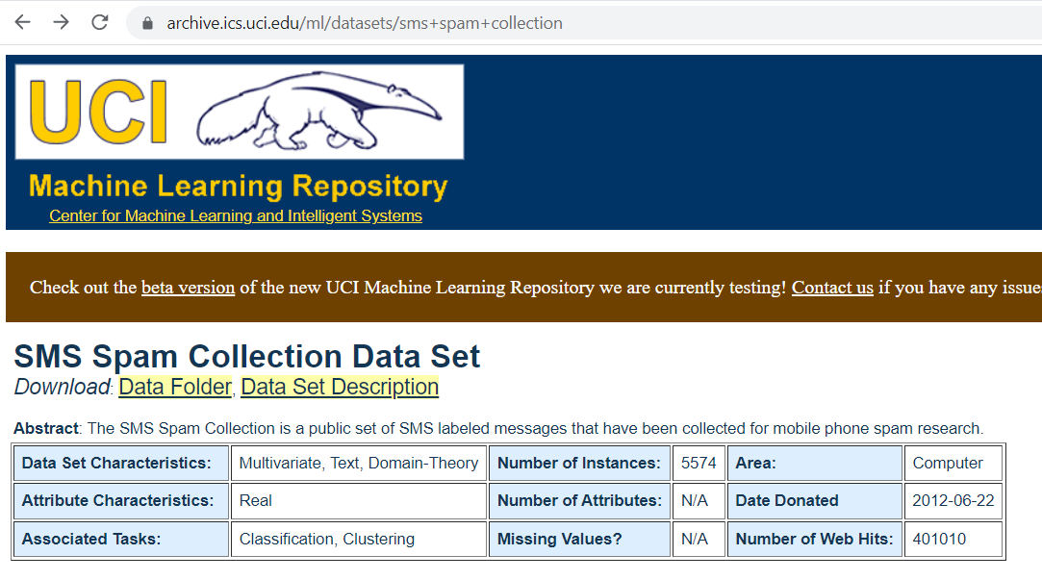
Textual Data Collection
https://archive.ics.uci.edu/ml/datasets/sms+spam+collection
Click on ‘Data Folder’ beside Download option

Slide 6
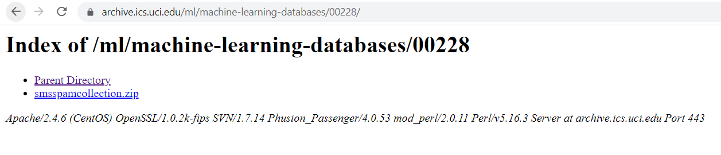
Textual Data Collection
Click on the ‘smssspamcollection.zip’ and download the zip file

Slide 7
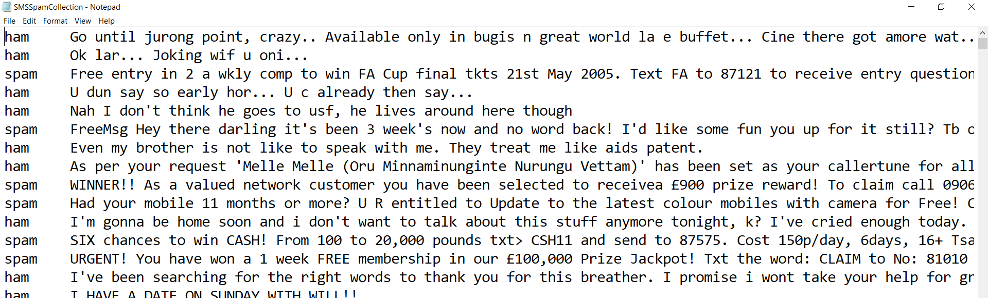
Textual Data Collection
Here we need to find whether the message sent is a spam or a ham

Slide 8
Exploratory Data Analysis
Know Your Data
--Exploratory Data Analysis--
Note! Do not perform the EDA on Test/Holdout data

Slide 9
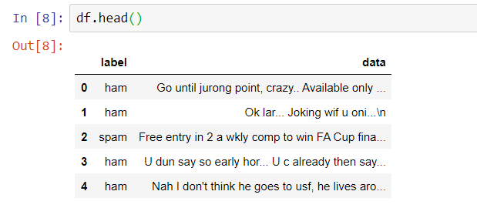
Exploratory Data Analysis

Slide 10
Text Preprocessing
Text Normalization
The following pre-processing steps have to be performed:
Case Normalization: Convert the All the capital letters to small letters
Number Normalization: Remove all the numbers present in the text
Punctuation removal: Remove all the punctuation present in the text
Stop word removal: Remove all the stop words like ‘and’ etc. from the text
Stemming/lemmatization: Either Stemming or lemmatization must be performed

Slide 11
Text Preprocessing
Text Normalization
Exploratory Data Analysis
Get the list of unique words
Get the Frequency of every word

Slide 12
Vectorization and Feature Engineering
Generate BOW from the vocabulary – use Sklearn

Slide 13

Modelling or Pattern Mining
The Naïve Bayes algorithm is classification algorithm depending on the Bayes theorem
The assumptions which are made are:
Naïve Bayes is a concept of probability

Slide 14
Evaluation and Deployment
Check predictions against the actual label !

Slide 15
Evaluation and Deployment
Save the model , Reload the model to be used on other dataset

Slide 16
Q&A

Slide 17
Assignment
Work on the below dataset based on the work which was demonstrated
https://www.kaggle.com/prashant111/naive-bayes-classifier-in-python/data?select=adult.csv
Using the Naïve Bayes classifier using the python modules which were used
Test and evaluate the model and save the classifier using pickle module as
‘naïve_bayes.pickle’ and load the module and test whether it has been loaded

